Slide 1
Intro to git / github.com
Version control and code sharing
Terence Parr
MSDS program University of San Francisco
See https://github.com/parrt/msds501/blob/master/notes/git.md

Slide 2
What is git?
Git is a version control system that tracks changes to files and directories within a repository
A repository is just a directory subtree containing files and directories that we tell git to treat as a repository
Git allows multiple workers to operate on two different copies of the repository without getting confused or losing changes
Workers push/pull changes from a repo on one machine to a repo on a collaborator’s machine
Git is a program that runs on your laptop
See https://github.com/parrt/msds501/blob/master/notes/git.md

Slide 3
What is github.com?
Github.com is a website that hosts repositories, making collaboration much easier
A web interface to your repo files
A free backup!
Note: git != github.com
git is program
github is a web site/server
For our purposes, we’ll ignore the advanced capabilities, such as branching and merging
See github learning resources

Slide 4
Motivation
Every commercial developer uses version control at work
Every company you encounter uses it
For that reason alone, you need to learn version control to be functional in a commercial setting, such as your practicum
In this class and future classes, you will also use version control to submit your work

Slide 5
An analogy to backup systems
If your laptop is stolen, we will be sympathetic but not excuse missing projects
github doubles as a backup
but I recommend you also get backblaze to keep off-site backups of your disk
Personally, I also have a local Timemachine OS X backup drive sitting next to my computer that takes a snapshot every hour
Using this multi-tiered backup strategy is a good way to think about how programmers use version control
git is kind of like Time Machine, a local backup (that tracks changes)
github.com is kind of like the off-site backblaze cloud-based backup
The difference between git and a backup system is that we tell git when to take a snapshot
Each snapshot should be a logical chunk of work done to your files

Slide 6
Repositories (Repos)
Not only do we have to tell git when to take a snapshot, we also tell it what files to pay attention to (in the repo directory)
Each project you work on is in a directory and all of the files associated with that project sit somewhere under that subtree
The file set is called a repository and at any given time, my computer has lots and lots of these repositories
A git repository instance is just a directory but it also has a .git (hidden) directory, with a database of all changes
To remove a repo, just rm the whole repo directory; there is no central server to notify

Slide 7
Committing changes
As with the Time Machine backup, git tracks snapshots as the difference from the last time you requested a snapshot
Each snapshot is called a commit (and programmers think of these commits as transactions)
Perform a commit to lock in a logical chunk of work, such as the addition of a feature or fixing of a bug

Slide 8
Commit log (history)
Having a complete list of changes is extremely useful
We can revert those change sets later
We can discover who created or when a bug was introduced
Can temporarily reset your repository to a moment in time

Slide 9
Cloning from, pushing to github
Continuing with the analogy now, github.com is like the off-site cloud-based backup
Each repo you mirror at github is like a free backup
We’ll likely create a repo using a web interface at github then clone that repo to an (initially empty) directory on our laptops
As with committing changes, we also have to specifically push changes to the local repository back to github
Every push ensures that the complete file set and git change database (in .git subdirectory) is mirrored at github

Slide 10
Collaboration
I can access your repos mirrored on github, whereas I have no access to your laptop drive
To grade projects, I will clone your repository onto my disk
If you make changes, I can pull those in after you commit/push
I can make comments and then push back to your github repo, which you can then pull down to your laptop
This is how multiple programmers communicate, and how I share work between my work and home machines

Slide 11
Key commands summary
I recommend using a git GUI like fork in practice, but we’ll use the command line to learn the actual operations and sequence
git clone github_url
git add file_or_dir
git commit -a -m ‘commit message’
git status
git push origin main (main could be called master)
git pull origin main
git rm filename
git mv from_filename to_filename
git reset --hard HEAD
git checkout – filename

Slide 12
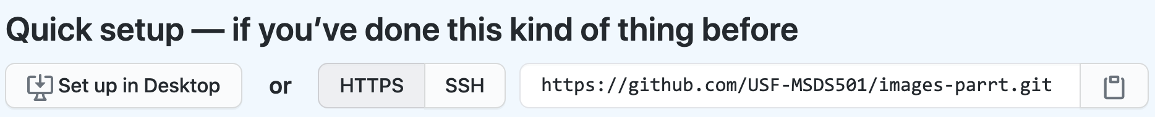

Typical startup sequence
Click on the invitation URL sent to you by instructor to create a repository, which creates repo at github: https://github.com/USF-MSDS501/images-parrt
Get the URL from the "Code" dialog at github, which looks similar to repo's github web page URL: https://github.com/USF-MSDS501/images-parrt.git
Clone that (empty) repo onto your laptop from command line:
See project description https://github.com/parrt/msds501/blob/master/projects/images.md

Slide 13
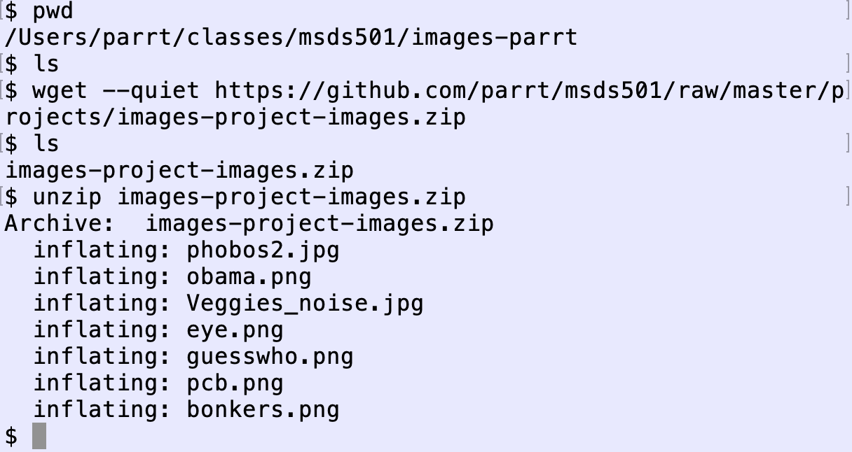
Getting some initial files
In the directory created during cloning, you will create and edit files associated with the repository
Let's download and unzip some images needed for your project
See project description https://github.com/parrt/msds501/blob/master/projects/images.md

Slide 14
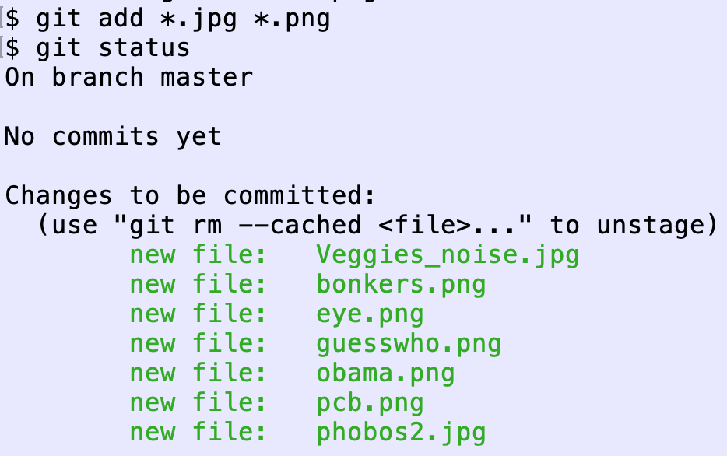
Adding files to the repo
git ignores files unless we tell ask it to pay attention; it's not enough just to put files into the repository directory
“git add” the files of interest so git knows to manage them
Check status; git now sees files
See project description https://github.com/parrt/msds501/blob/master/projects/images.md

Slide 15
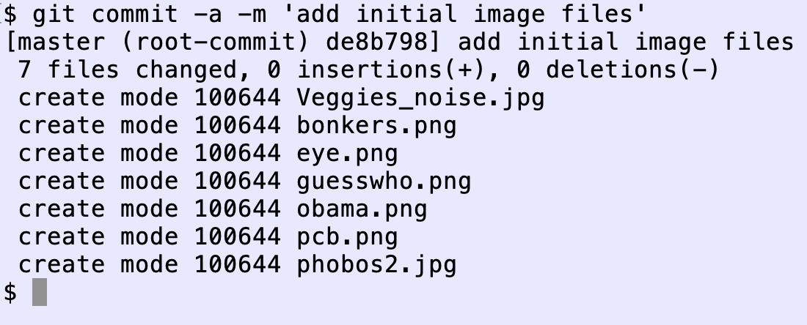
Commit a transaction
Commit tells git to take a snapshot and record it in its log of changes
Additions, deletions, renamings are all considered (reversible) changes
Use a decent commit message and don't forget the "-a" argument which means "do what this command should do by default"
See project description https://github.com/parrt/msds501/blob/master/projects/images.md

Slide 16
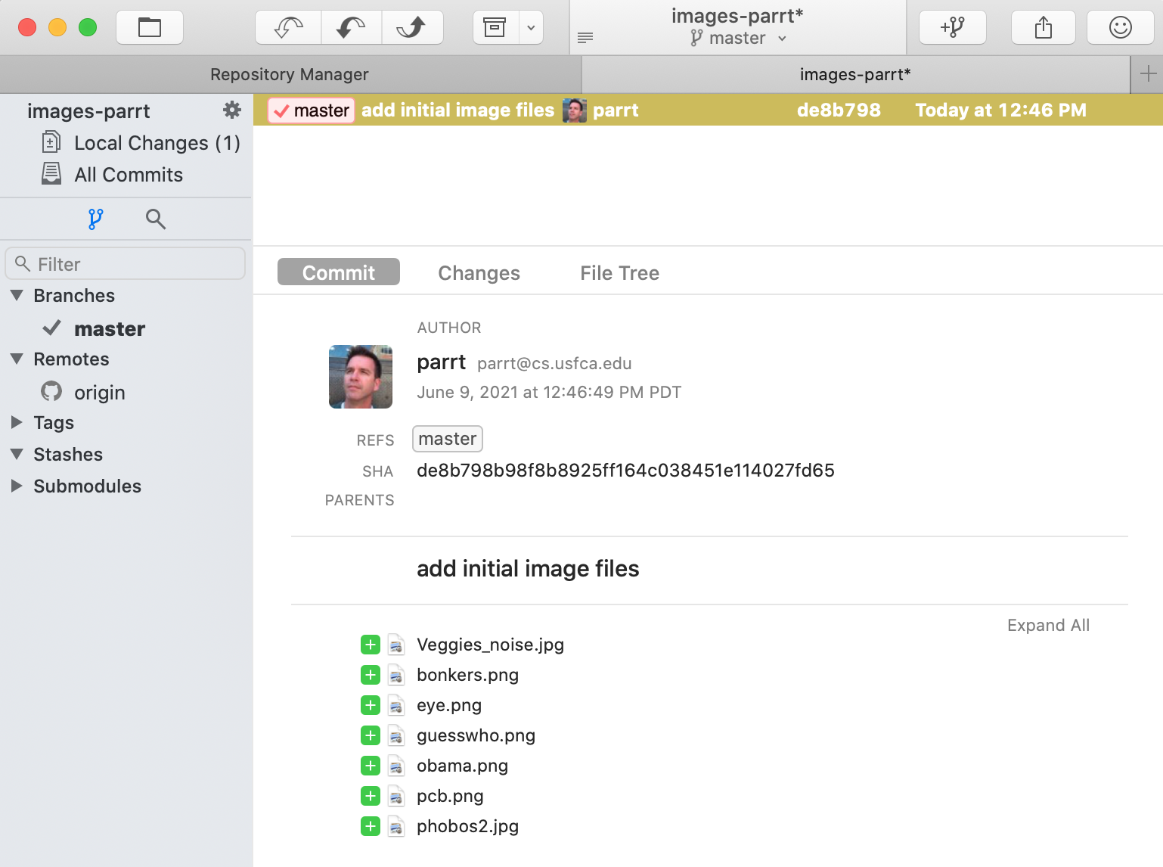
The fork GUI view
There is only one commit but you can see the commit message and the files involved in the transaction
You can also see the origin remote repository is connected because it's listed in the left gutter

Slide 17
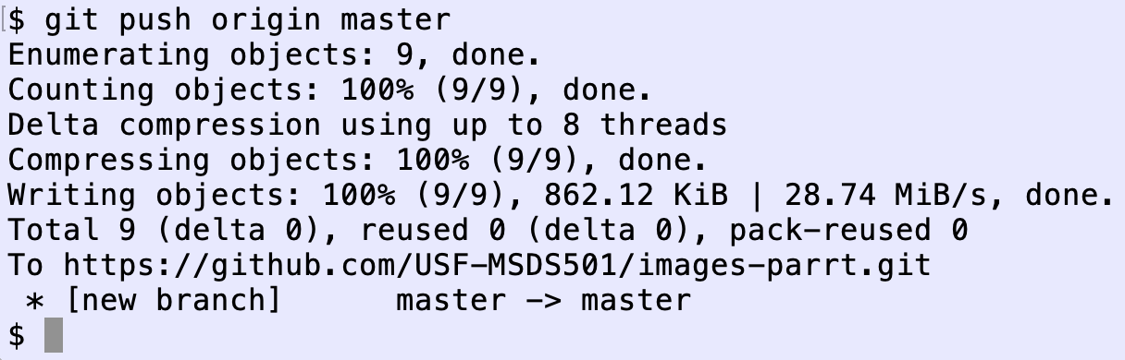
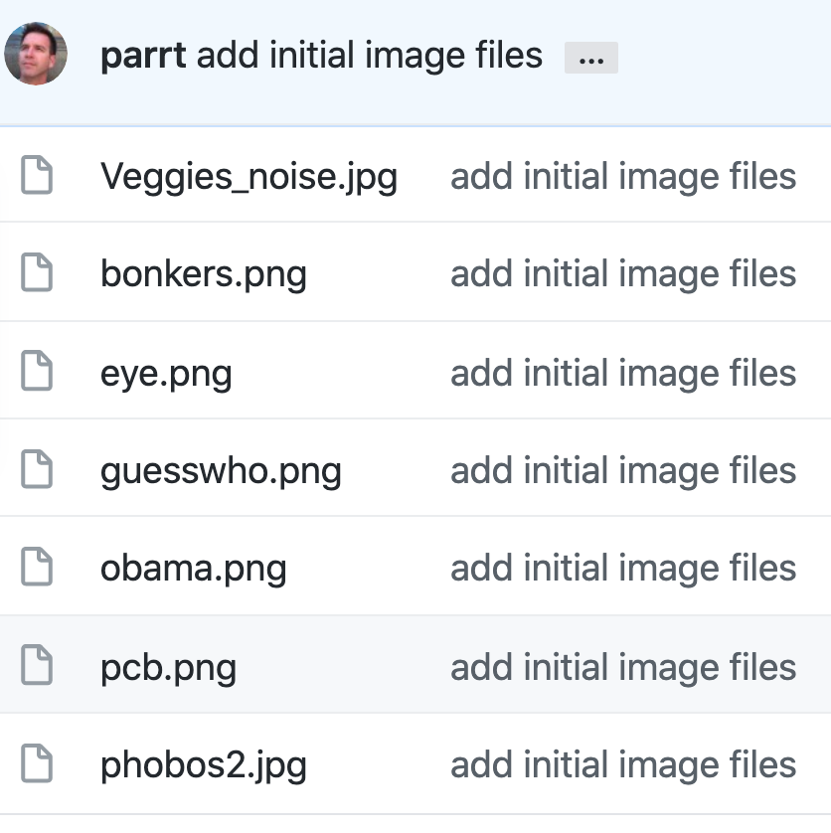
Push to github to mirror repo
Github does not know about your changes unless you explicitly push after committing
We're ignoring branches but we need to know what the main branch is called; it's either master or main (legacy is master)
Check github webpage for your repo and you'll see the files
See project description https://github.com/parrt/msds501/blob/master/projects/images.md

Slide 18
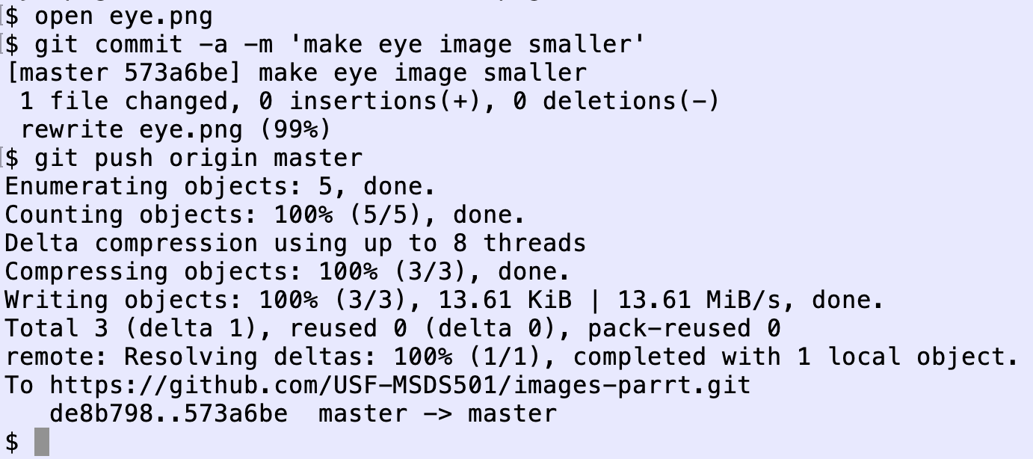
Making edits, mirroring on github
During the normal course of software development, you will edit files and then commit these changes, pushing to github
Here, I'm editing an image to make it a bit smaller

Slide 19
Pull in changes from github
If there are changes pushed to github that you do not have in your laptop copy, you must pull in those changes with: git pull origin main
This happens when I have cloned and added grading results to your repository and pushed them back, or you are working with a partner on a project; both of you push/pull via same github repo

Slide 20
Miscellaneous but useful commands
git rm filename Remove a file from the directory and from git repo tracking
git mv from_filename to_filename Rename a file or directory managed by git
git reset --hard HEAD Wipe out any changes you've made to managed files, resetting the repository to the most recent commit
git checkout -- filename Undo changes made to a single file managed by git, resetting to the state of that file at the most recent commit

Slide 21
A warning
git is ridiculously complicated and has a terrible interface in my opinion so proceed with caution!
I recommend sticking with a few commands: clone/add/commit/push/pull/rm/mv
Do NOT do branching/merging until you are much more comfortable with git and version control systems
Anything beyond these simple commands, I avoid or use very carefully after reading the manual

